Slide 1
Building Enterprise Java Applications with Spring
Day 4
Magdalene Lim,
Desmond Lee,
Kavitha Muniraj
Republic Polytechnic

Slide 2
Welcome and admin matters
Please ensure that:
Attendance has been captured (via QR code scanning)
A learning laptop is with you
Good view on the display
Course materials are also available at: https://github.com/kavithamuniraj/CETSpringBootAY2022
Notes:
https://en.wikipedia.org/wiki/QR_code_payment

Slide 3
Admin matters
A tidy/clean laptop is a good laptop for learning
Files created on the laptop will linger on. To prevent this:
Create a folder in the "Documents" location for this workshop
E.g. “SpringBoot-Alan" or “SpringBoot-PeterPan“
All user created files to be placed in this folder
Delete that folder after the course
Notes:
https://en.wikipedia.org/wiki/QR_code_payment

Slide 4



Trainers
Magdalene Lim
Senior Lecturer
School of Infocomm
Magdalene_lim@rp.edu.sg
Desmond Lee
Associate Lecturer
School of Infocomm
DESMOND_LEE@myrp.edu.sg
Kavitha Muniraj
Lecturer
School of Infocomm
Kavitha_muniraj2@rp.edu.sg
Notes:
https://en.wikipedia.org/wiki/QR_code_payment

Slide 5
Schedule
Time | Agenda
9:00 am - 9:15 am | Welcome and admin matters
9:15 am – 10:30 am | Uploading Image using Form
10:30 am – 10:45 am | Break
10:45 am – 12:30 pm | Manipulating Data – Update
12:30 pm – 1:30 pm | Lunch
1:30 pm – 3:15 pm | Manipulating Data – Delete
3:15 pm – 3:30 pm | Break
3:30 pm – 4:45 pm | Lab Session – help with errors or clarification about codes
4:45 pm – 5:00 pm | Wrap up, Q&A
Notes:
https://en.wikipedia.org/wiki/QR_code_payment

Slide 6
Topics Covered in this course
Uploading Image using Forms
Updata and Delete data from Database
Notes:
https://en.wikipedia.org/wiki/QR_code_payment

Slide 7

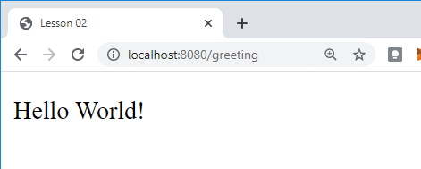
RECALL - REST API – Client Server Model
1. The client makes a request
http://localhost:8080/greeting
2. The web server receives the request and passes it to the controller.
3. GreetingController.java processes request and returns response (View)
greeting.html
(View)
4. The client displays the response received.
Notes:
What web server are we using?

Slide 8
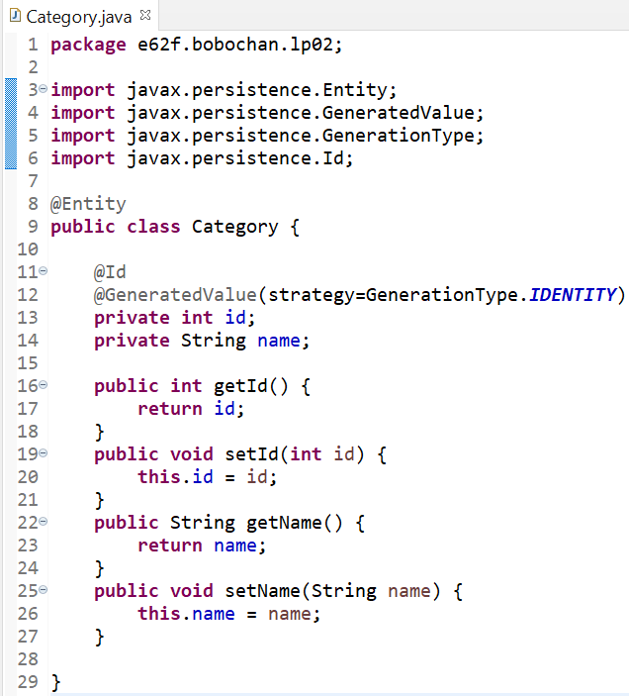
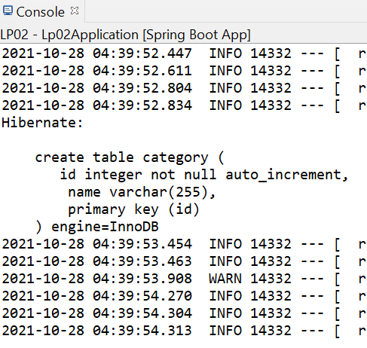
RECALL - JPA-Hibernate-MySQL
Springboot application
Spring Data JPA
Hibernate ORM Framework
MySQL DB

Slide 9
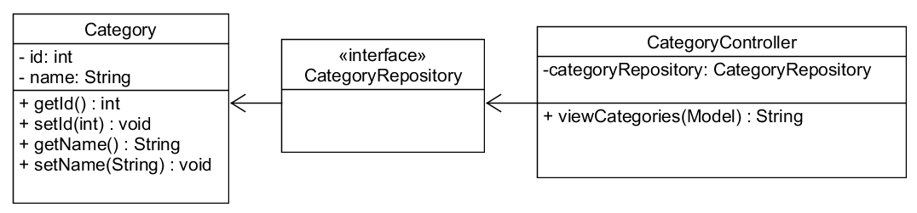
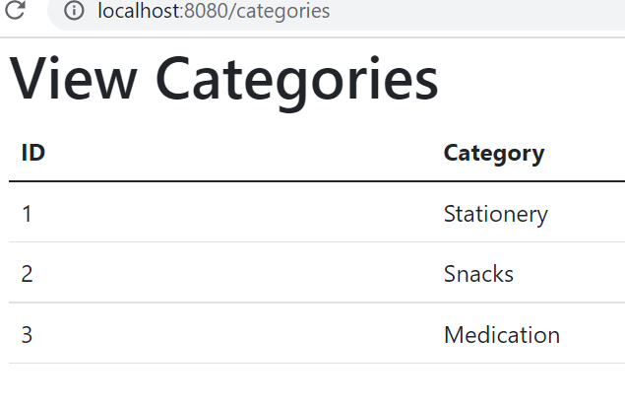
RECALL - Viewing a list of categories

Slide 10
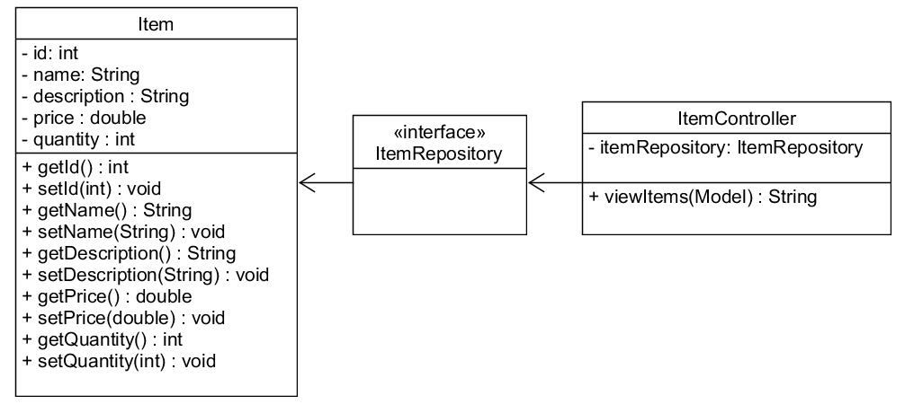
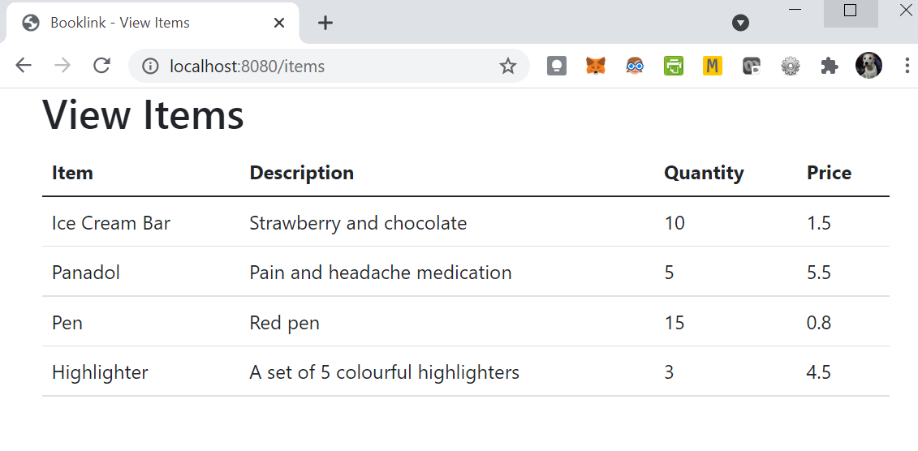
RECALL - Viewing a list of items

Slide 11
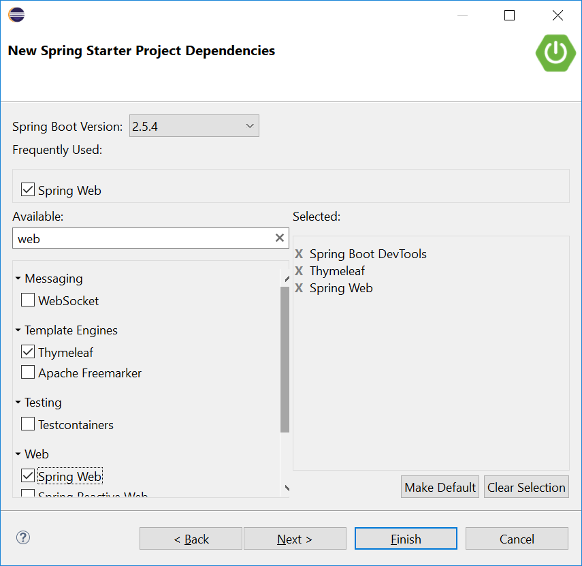
RECALL - Thymeleaf
Recall that in our Springboot projects, we included a dependency, Thymeleaf.
Thymeleaf is a server-side Java template engine for both web and standalone environments.
It is a view technology that performs server-side rendering of HTML.
We use variable expressions ${…} bind the data from the template context(model) into the resulting html(view).

Slide 12
RECALL: Thymeleaf attributes
th:each - used for iteration
th:text - evaluates its variable expression and sets the result of this as the body of the tag it is in
As we progress in the lessons, we will be using more types of attributes. You can find the full list here:
https://www.thymeleaf.org/doc/tutorials/3.0/usingthymeleaf.html#setting-attribute-values

Slide 13
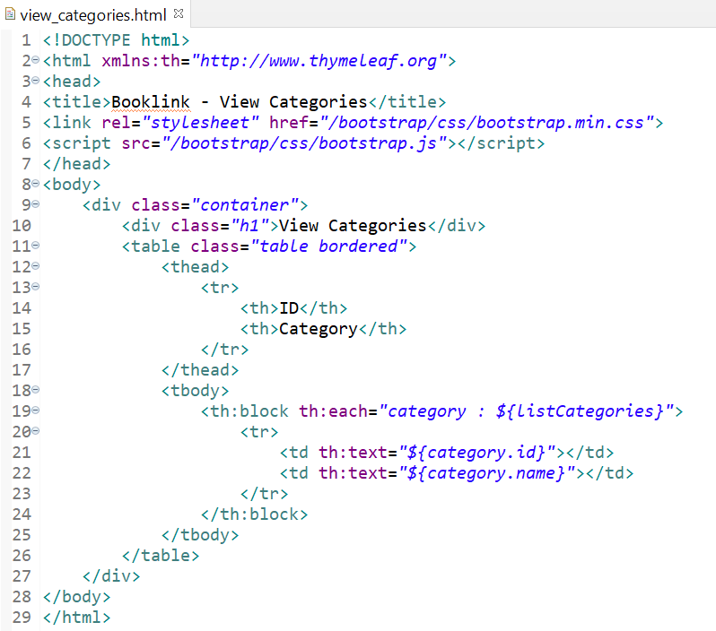
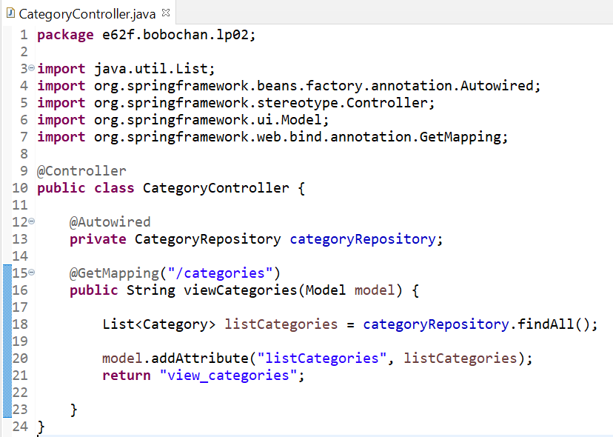
RECALL –View Categories
We used the variable expression ${…} to retrieve the information stored in the model attributes.

Slide 14
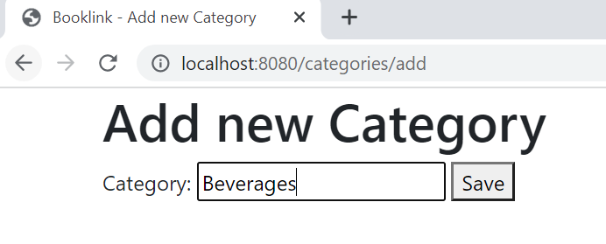
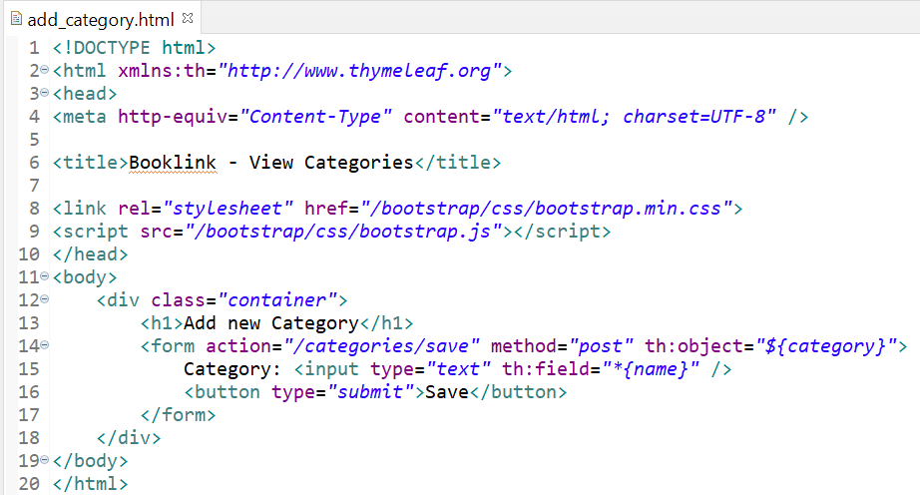
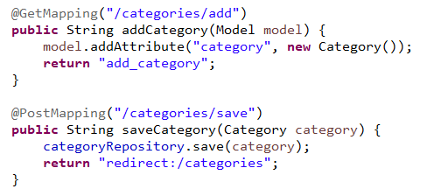
Add a new Category using Forms
1. When the Save button is clicked, the data will be sent via the POST method to the location set in the action attribute of the form
2. The details will be passed as a category object to the method, saveCategory.
3. The category object containing the new information will be saved to the database using the save method from categoryRepository object.
Recall that the JpaRepository helps us with CRUD. No additional SQL is required to insert the data into the database.
4. After saving the new category, the page is then redirected to http://localhost:8080/categories/

Slide 15
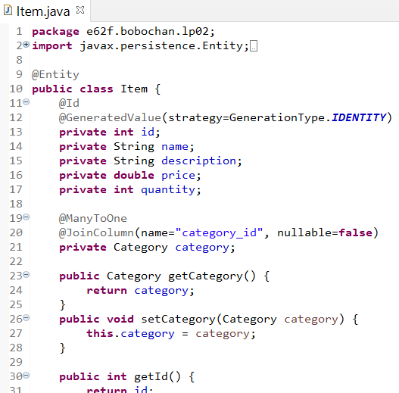
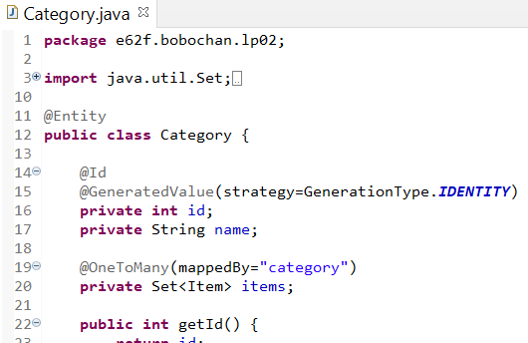
Joining Table – Category and Item
@JoinColumn defines the column to join the category and item tables.
The @OneToMany and @ManyToOne describes the relationship between the 2 entities.
A Set is a collection that does not contain any duplicate objects. In this case, items will not contain any duplicate Item objects. The @OneToMany annotation will be applied to items.
Category object added as a field here. The annotations @ManyToOne and @JoinColumn above will be applied to category.
mappedBy indicates link to category object in the Item class.

Slide 16
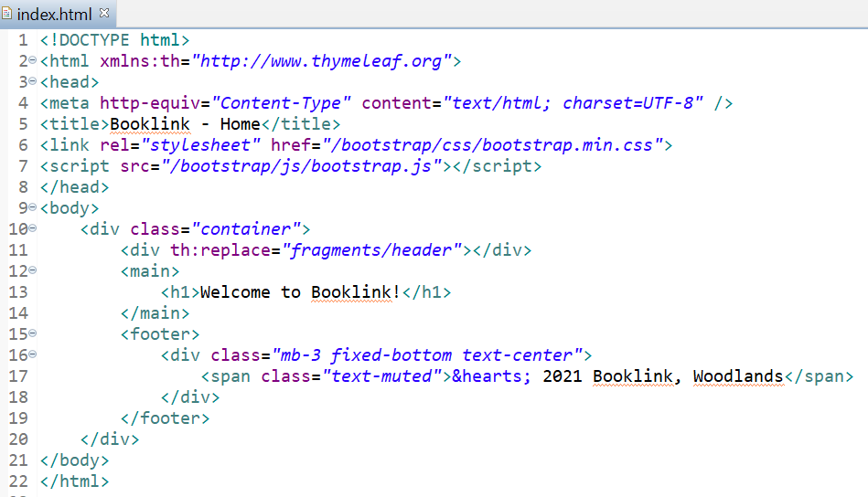
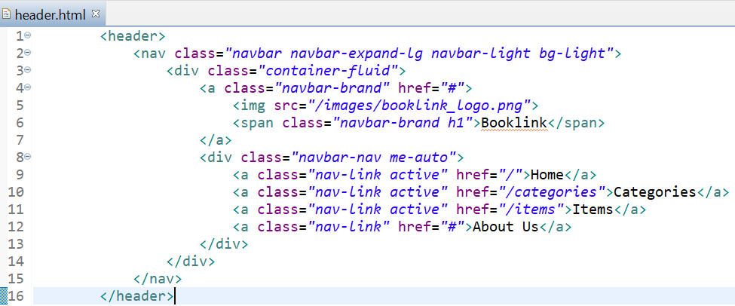
Creating header fragment
From index.html, copy the header HTML code and paste it inside header.html.
In index.html, replace the header code with the reference to the fragment as shown.
Note that the mappings here are handled automatically by Thymeleaf.
We do not need to create the mappings ourselves in the controllers.

Slide 17
Uploading Images

Slide 18
Image upload
As of now, we can display images on a page by placing them in the static folder under src/main/resources.
This is suitable for images related to the organization website branding.
However, if we have images such as new products or services being added to the website, we should store these images in a folder not part of the main project code.

Slide 19
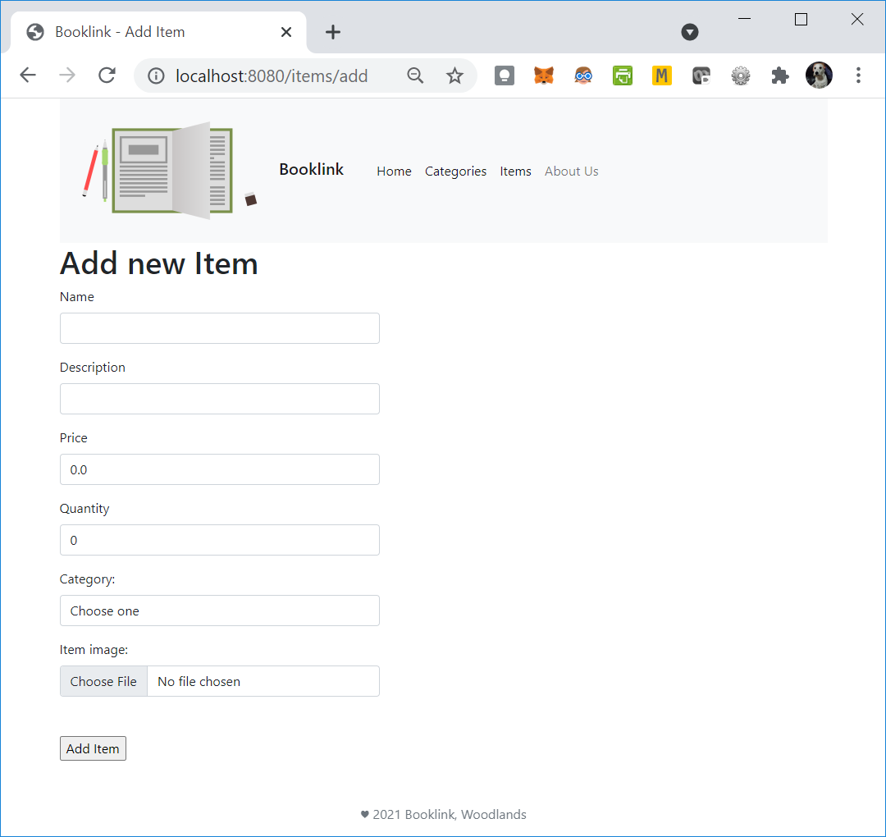
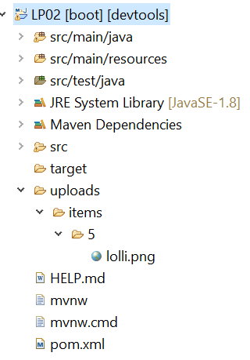
Image upload
We will store uploaded images in the LP02 project folder, but not part of the main code. You can also specify your own location to store uploaded images.

Slide 20
Image upload
To handle the dynamic image file uploads, we will need to do the following:
Modify Item.java to include an additional field to store the file name
Modify add_item.html to allow and include an input for file uploading
Modify ItemController.java to save the image name and store the images in a separate folder
Include a new config class which we will name BooklinkConfig.java to enable access to the folder so that the images can be displayed.

Slide 21
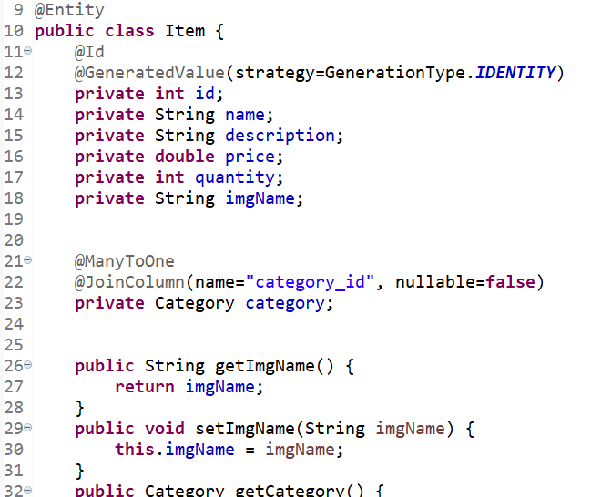
Exercise 1 - Image upload – Item model
Modify Item.java to include a new field named imgName
Generate the getters and setters for this new field.
Paste the code in your worksheet.

Slide 22
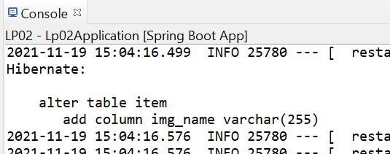
Exercise 1 - Image upload – Item model
Save Item.java
You should see the following output in the console
Refresh the database tables, you should see the new column added.

Slide 23
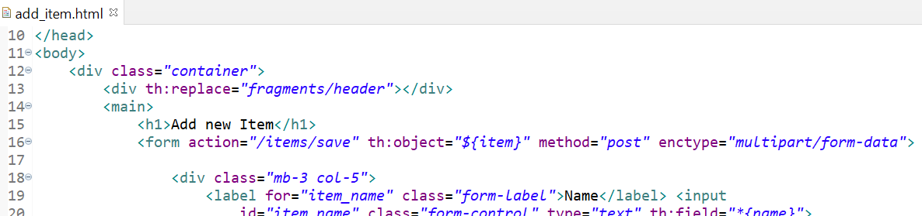
Exercise 2 - Image upload – Item view
Modify add_item.html to include the enctype attribute in the form element

Slide 24
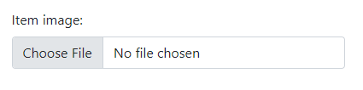
Exercise 2 - Image upload – Item view
Modify add_item.html to include a file input to upload the image within the form element.

Slide 25
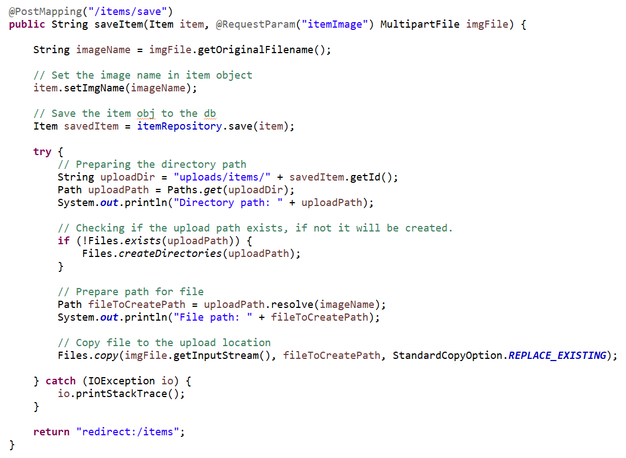
Exercise 2 - Image upload – Item controller
In ItemController.java, modify the saveItem method.

Slide 26
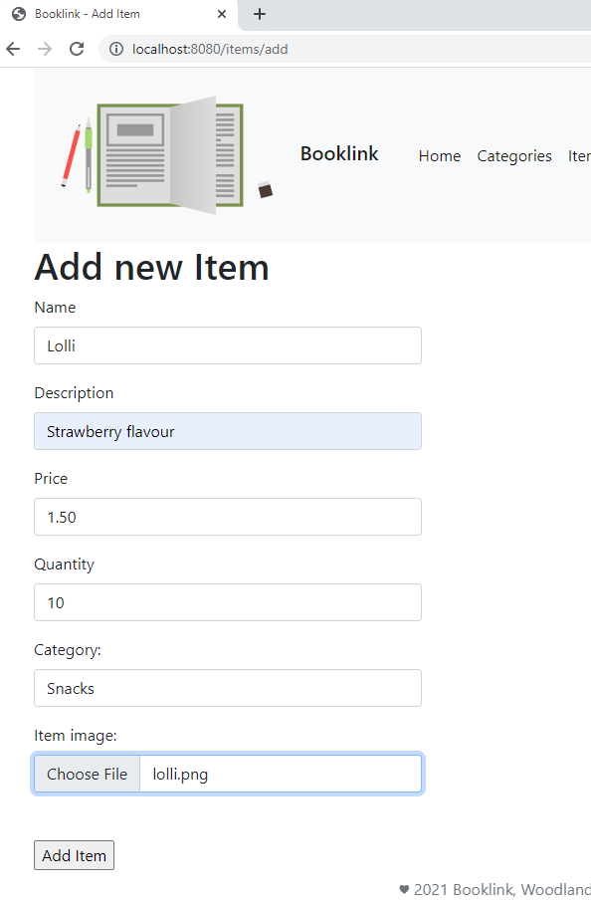
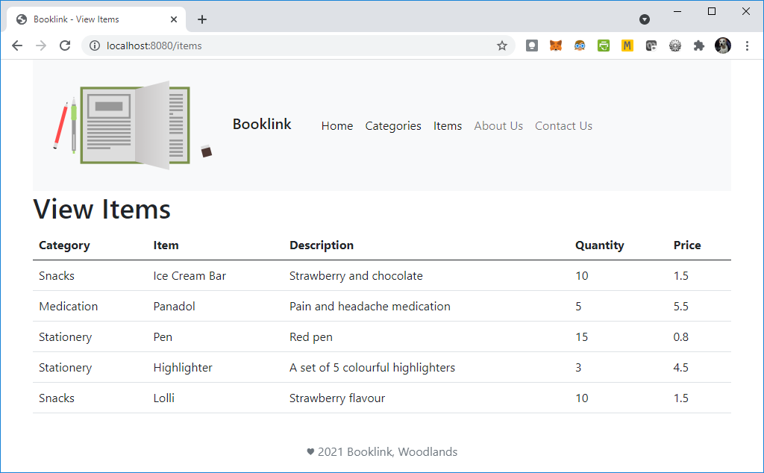
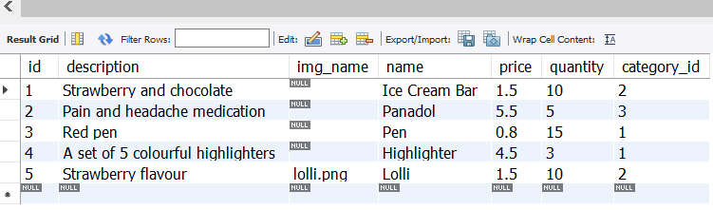
Exercise 2 - Image upload – Item controller
Try adding a new item to see the details are stored in the database and the image file is uploaded.

Slide 27
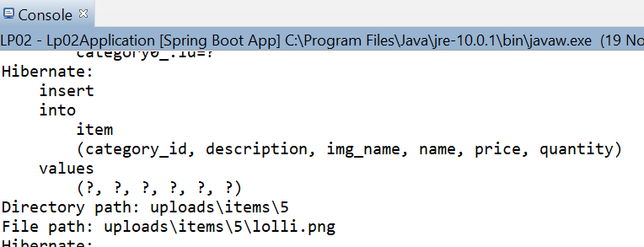
How it works
1. The enctype must be set to multipart/form-data if we have any input of type file.
2. Input name and requested param name must match
3. The id here is 5 as we already have 4 items added previously. The id may be different for you depending on how many items you added before this exercise.

Slide 28
Viewing uploaded files
As the folder that we have created is a new folder, we need to enable access to this new folder so that the images can be viewed.
Before we do that, let’s create a page to view a single item.

Slide 29
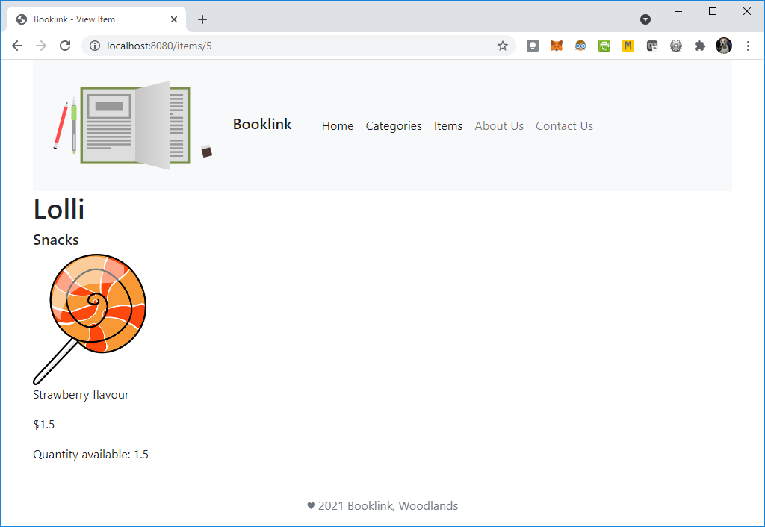
View Single Item - Viewing uploaded image
To view a single item on a web page, we will have to:
Modify view_items.html to link the name of the item to view the details of files
Modify ItemController.java to include a new method and mapping for viewing a single item
Create a view named view_single_item.html.

Slide 30
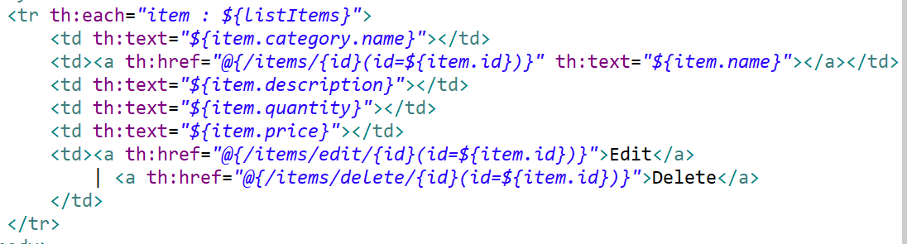
View Single Item – link in Items list
Modify view_items.html to link the name of the item to view the details of files

Slide 31
Exercise 3 – View Single Item - Controller
To map to the view, should we use the @GetMapping or the @PostMapping? Why?
Previously, to retrieve a list of items from itemRepository, we used the findAll method. What method can we use to retrieve a single item?
Hint: https://docs.spring.io/spring-data/jpa/docs/current/api/org/springframework/data/jpa/repository/JpaRepository.html

Slide 32
Exercise 3 – View Single item - Controller
To map to the view, should we use the @GetMapping or the @PostMapping? Why?
We should use the @GetMapping as we are not submitting any information to be saved. Rather, we are retrieving data to be displayed.

Slide 33
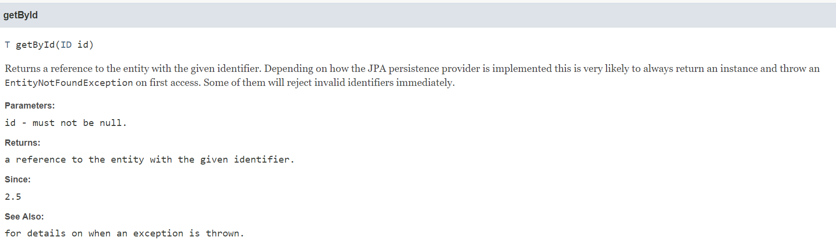
Exercise 3 – View Single item - Controller
Previously, to retrieve a list of items from itemRepository, we used the findAll method. What method can we use to retrieve a single item?
We can use the getById method that’s made available by JpaRepository
What is T ?
https://docs.spring.io/spring-data/jpa/docs/current/api/org/springframework/data/jpa/repository/JpaRepository.html#getById-ID-

Slide 34
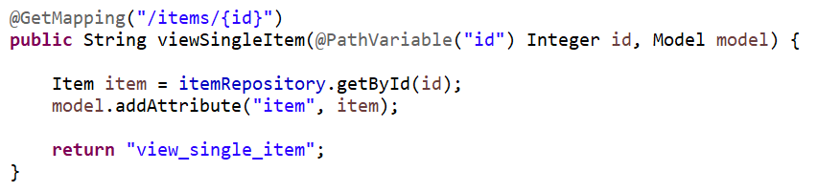
Exercise 3 – View Single item - Controller
Modify ItemController.java to include the viewSingleItem method as shown.

Slide 35
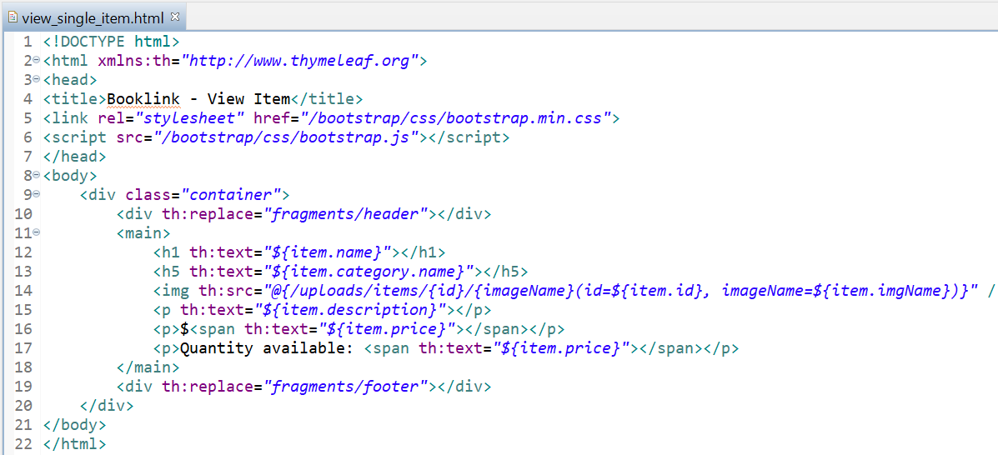
Exercise 4 – View Single item - View
Create a new view named view_single_item.html.
Include the code as shown
Notes:
The code shown here is fairly simple just to show how students can retrieve the information Students should improve on the design.

Slide 36
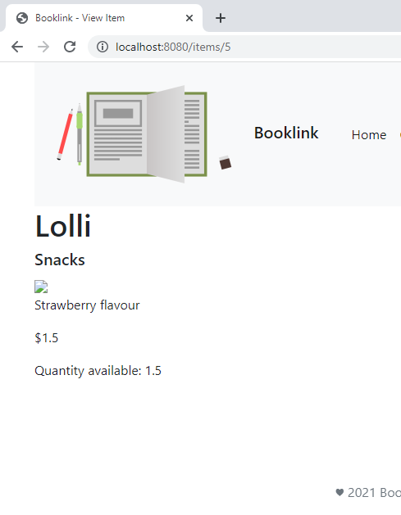
Exercise 4 – View Single item - View
Browse to http://localhost:8080/items/5
Note: Change the id to the latest item that you just added with an image.
The image will not be visible at the moment as we have not yet enabled the access to the folder.

Slide 37
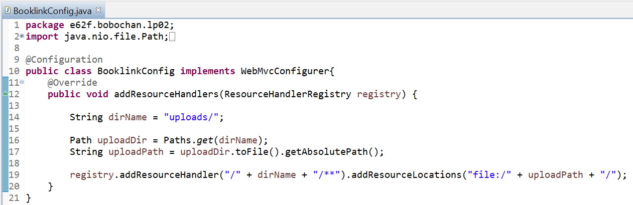
Exercise 4 – View Single item - Configuration
In the same location as your Java files, create a new Java class named BooklinkConfig.
Modify the code in BooklinkConfig.java as shown
You can import all the required libraries by using Ctrl-Shift-o

Slide 38
Exercise 4 – View Single item - View
Refresh the page we attempted to view earlier (http://localhost:8080/items/5 )
Paste your code in the worksheet.
Notes:
Right-click on the web browser page to show the code generated, in particular for the image.

Slide 39
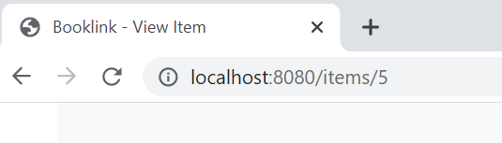
How it works
1. The id is passed to the mapping which is then passed to the method as a PathVariable.
2. The getById method uses the id to retrieve the item object.
3. The @{..} is a thymeleaf link expression, used to evaluate expressions in a url.
Here we passed 2 parameters separated by , .

Slide 40
How it works
1. @Configuration annotation is used here to indicate to Spring that this class should be instantiated and any dependencies should be injected
2. The WebMvcConfigurer is implemented here so that we can override the addResourceHandlers method to customize it for our purpose.
3. Stores registrations of resource handlers for serving static resources such as images, css files and others through Spring MVC. Resources can be served out of locations under web application root, from the classpath, and others.
Without adding a resource handler to the registry, we will not be able to access the resource, which resulted in our image not appearing on the website when we browsed to it earlier.
4. Adds a resource handler to serve static resources. The handler is invoked for requests that match one of the specified URL path patterns.
5. Adds a resource location from which to serve the files uploaded. The location must point to a valid directory

Slide 41

BREAK

Slide 42
Manipulating data - Update

Slide 43
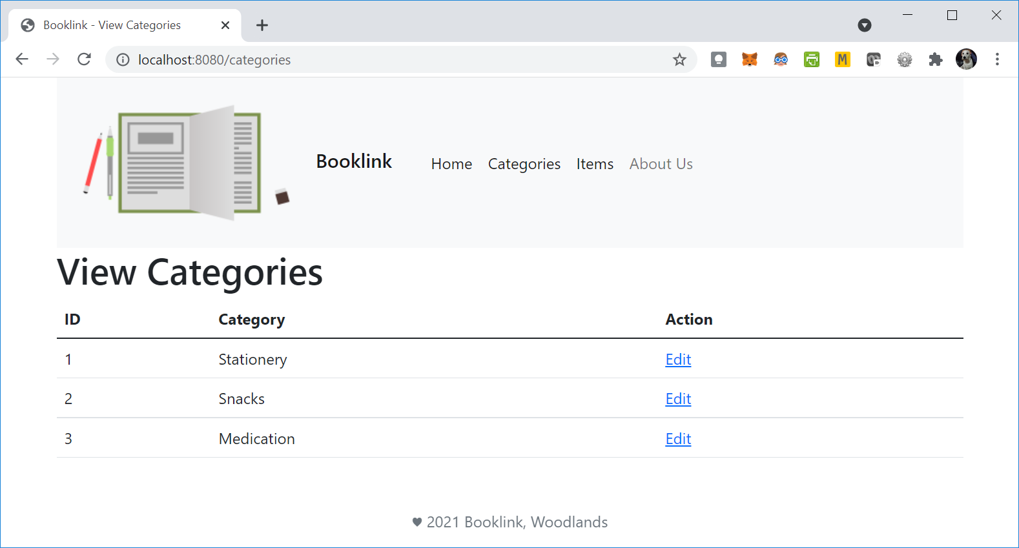
Manipulating Data
There may be times when a typo is made when adding details into the database, or when we simply want to update some information in the database.
In the image below, we can put an action column as shown to easily perform updates.

Slide 44
Manipulating Data
To edit category data, we will need to
Modify CategoryController.java
Modify view_categories.html
Create a view named edit_category.html

Slide 45
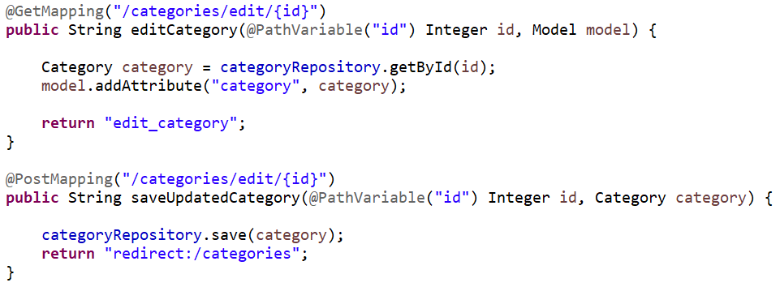
Exercise 5 – Update a category
Modify CategoryController.java to include the code as shown:

Slide 46
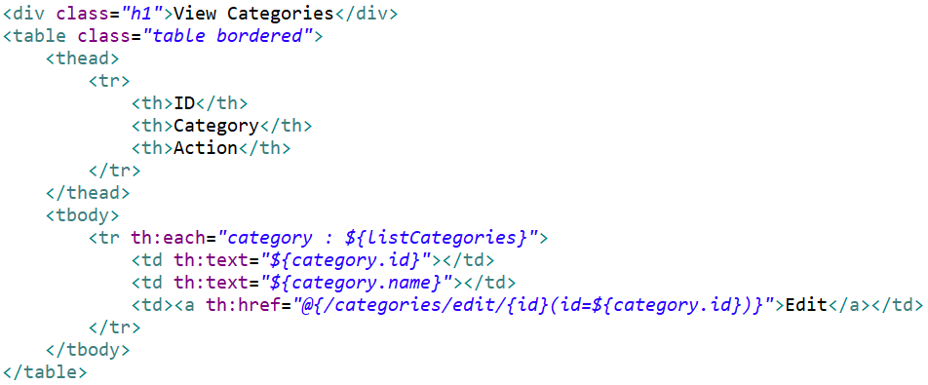
Exercise 5 – Update a category
Modify view_categories.html to include the code as shown:

Slide 47
Exercise 5 – Update a category
Create a new view named edit_category.html.
Note: Since we have an add form already created previously, we can make use of the form in edit_ category.html as it will be similar.
Copy the code from add_ category.html and paste into edit_ category.html.
Besides changing the “Add” text to “Update”, we will need to modify a few more things.

Slide 48
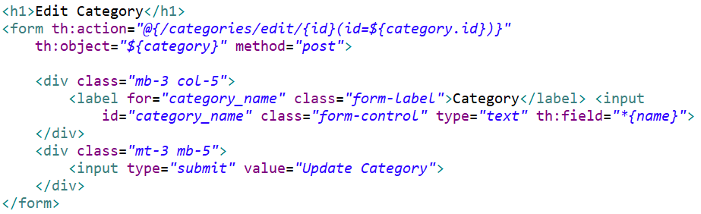
Exercise 5 – Update a category
In edit_ category.html, modify the form element as shown.

Slide 49
Exercise 5 – Update a category
Browse to http://localhost:8080/categories , you should see the below.
Click on the Edit hyperlink on one of the items.

Slide 50
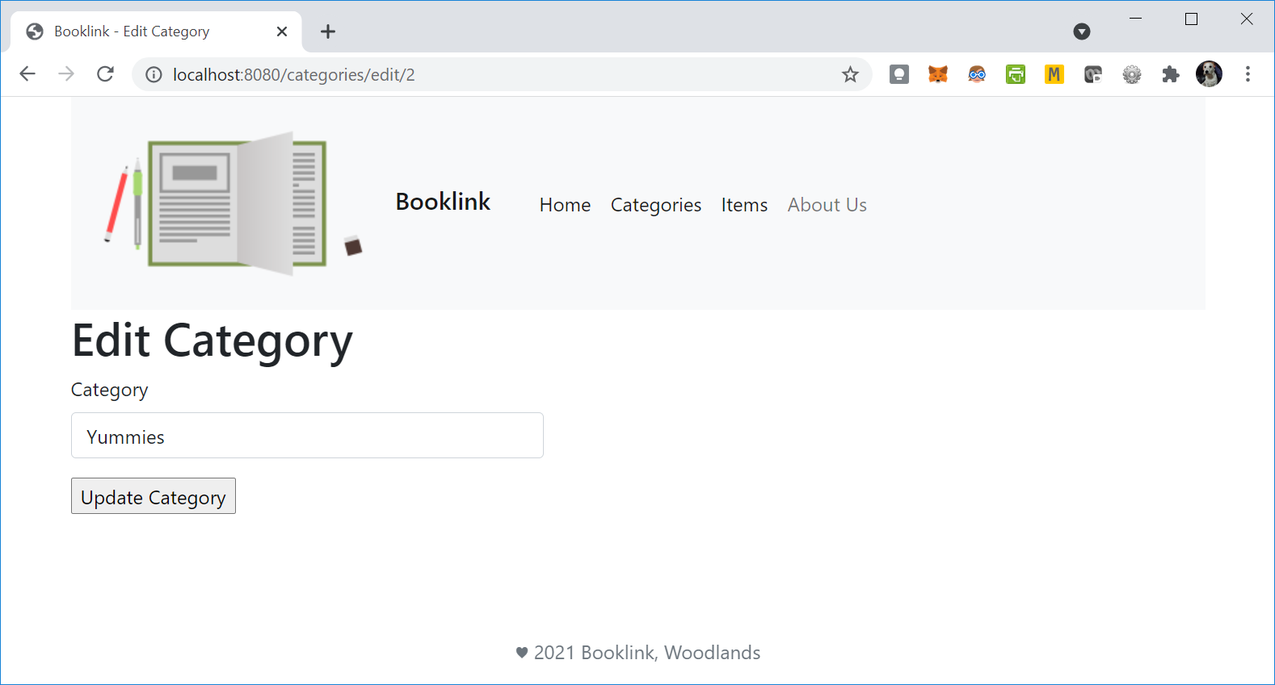

Exercise 5 – Update a category
Modify one of the values and click Update Category.
Paste the code in your worksheet

Slide 51
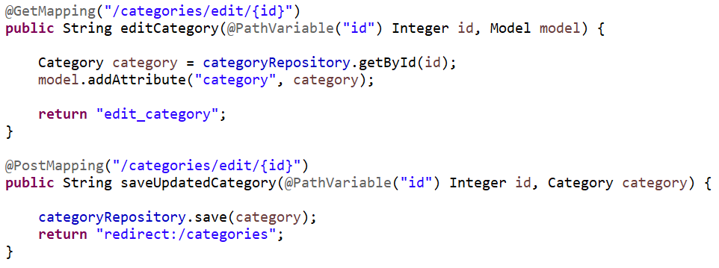
How it works
CategoryController.java
view_categories.html
When the link is clicked, this will be mapped against the @GetMapping(“/categories/edit/{id}”)

Slide 52
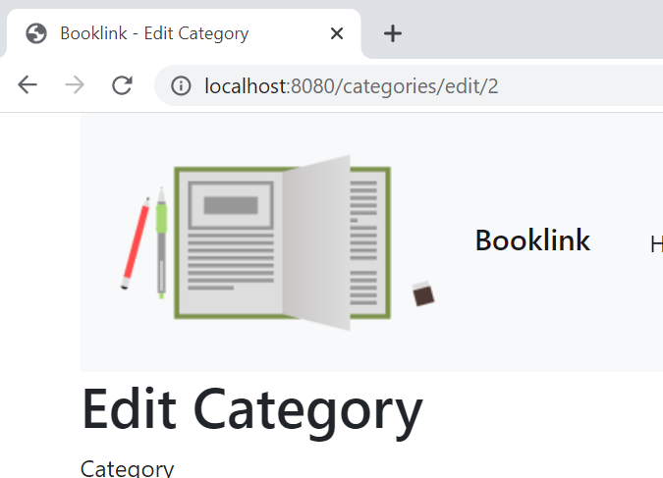
How it works
The @PathVariable is used to handle template variables in the request URI mapping, in this case, the item id. This will then be set as a method parameter, in this case also named id.
CategoryController.java
view_categories.html
As we use the thymeleaf link expression to help us include parameters, we pre-fix the href with th: to indicate this to be processed by thymeleaf.

Slide 53
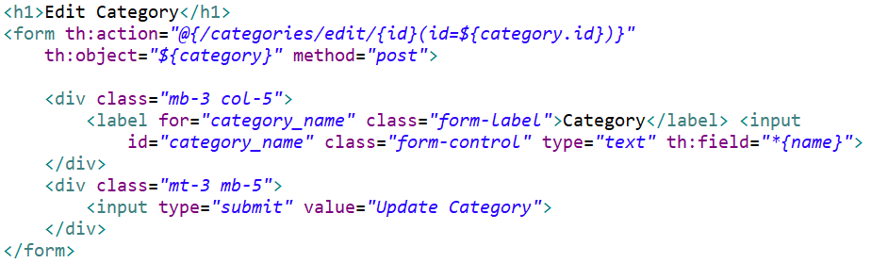
How it works
CategoryController.java
edit_category.html
When the Update Category button is clicked, the updated category will be sent to the path in the action attribute of the form, which will map to @PostMapping(“/categories/edit/{id}”)

Slide 54
How it works
CategoryController.java
edit_category.html
When the Update Category button is clicked, the updated category will be sent to the path in the action attribute of the form, which will map to @PostMapping(“/categories/edit/{id}”)

Slide 55

LUNCH

Slide 56
Manipulating data - Delete

Slide 57
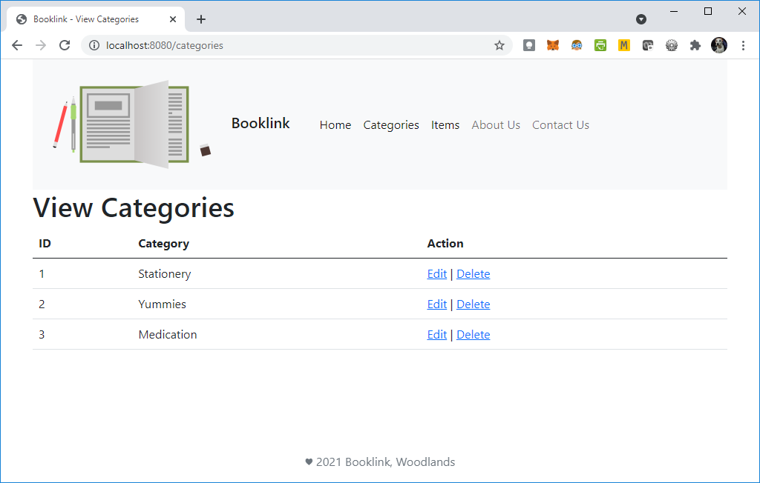
Manipulating Data
Besides updating data, we may sometimes need to completely remove some information stored in the database.
Let’s add a delete function to our web page.

Slide 58
Manipulating Data
To delete category data, we will need to
Modify CategoryController.java
Modify view_categories.html

Slide 59
Exercise 6 – Delete a category
To delete a category, which mapping should we use? Why?

Slide 60
Exercise 6 – Delete a category
To delete a category, which mapping should we use? Why?
We should use the @GetMapping as we are not submitting any information to be saved. In the case of deleting a category, we are using the id to first retrieve the category object, then remove it.

Slide 61
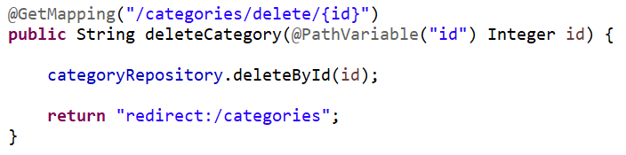
Exercise 6 – Delete a category
Modify CategoryController.java to include the code as shown:

Slide 62
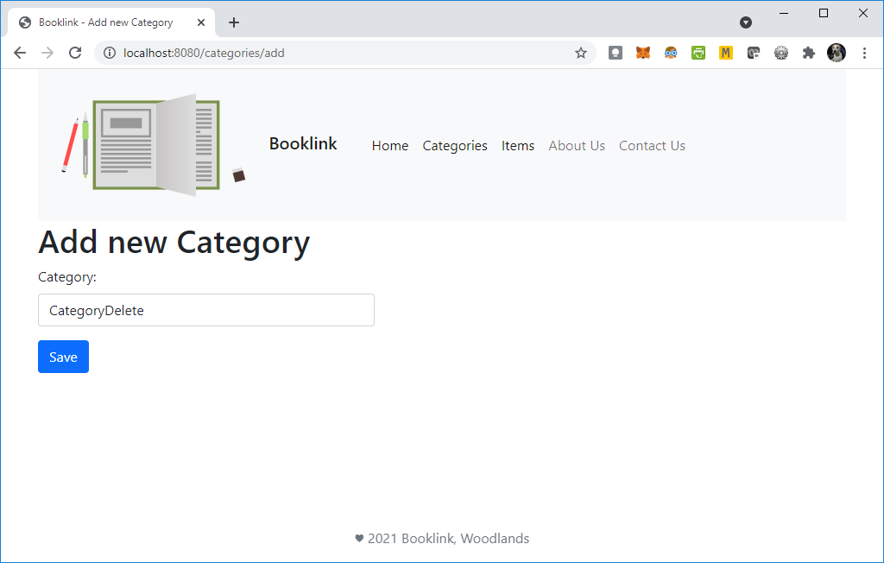
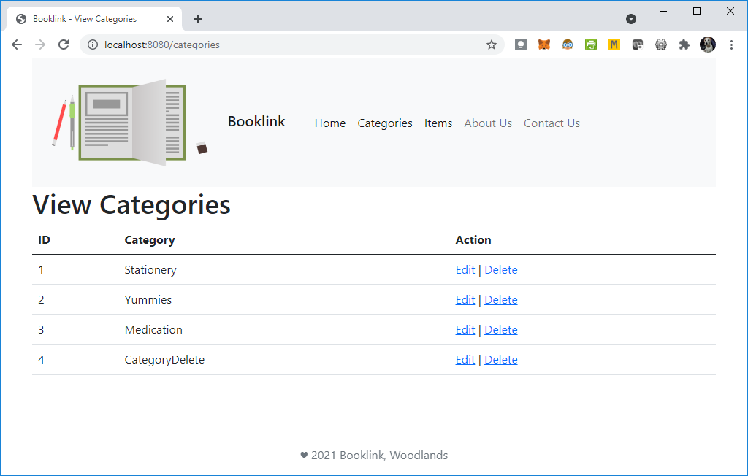
Exercise 6 – Delete a category
Before you test that the delete works, add a new category, and delete that new category.

Slide 63
Exercise 6 – Delete a category
Describe the process of what happened from the point you clicked on the Delete link in the View Categories page.

Slide 64
Exercise 6 – Delete a category
Describe the process of what happened from the point you clicked on the Delete link in the View Categories page.
From the delete link, the category id is passed to the deleteCategory method in CategoryController. The category is then deleted using the deleteById method.
Once deleted, we are redirected to the view categories page.

Slide 65
Exercise 7 – Update an item
Modify and create the necessary files to update items.
Modify ItemController.java
Modify view_items.html
Create a view named edit_item.html

Slide 66
Exercise 8 – Delete an item
Modify the necessary files to delete items.
Modify ItemController.java
Modify view_items.html

Slide 67
BREAK

Slide 68
Spring Boot Application LAB Session
Notes:
Similar to lesson 02 instructions

Slide 69
Summary
In this lesson, you learnt how to:
Upload images Dynamically using Forms
Manipulating Data in DB – Update
Manipulating Data in DB – Delete
Lab Session

Slide 70
Thank you Q&A

